Slide 1
Do’s (and don’ts) of getting ink
Or How to Leverage your Brand
Presented by:

Slide 2
Do: Have Clarity
Determine exactly what you want to accomplish:
Degree of visibility
Allocators only?
Allocators and showcase expertise?
Full blown marketing and PR program
Social media level
Don’t: expect everyone to be as impressed with you as you are but be confident.

Slide 3
Do: Be selective
Visibility is good to a selective segment, especially those who understand your market
Trade publications and websites
Database collectors
Business vendors
Specialized associations and groups
Managed Fund Blogs

Slide 4
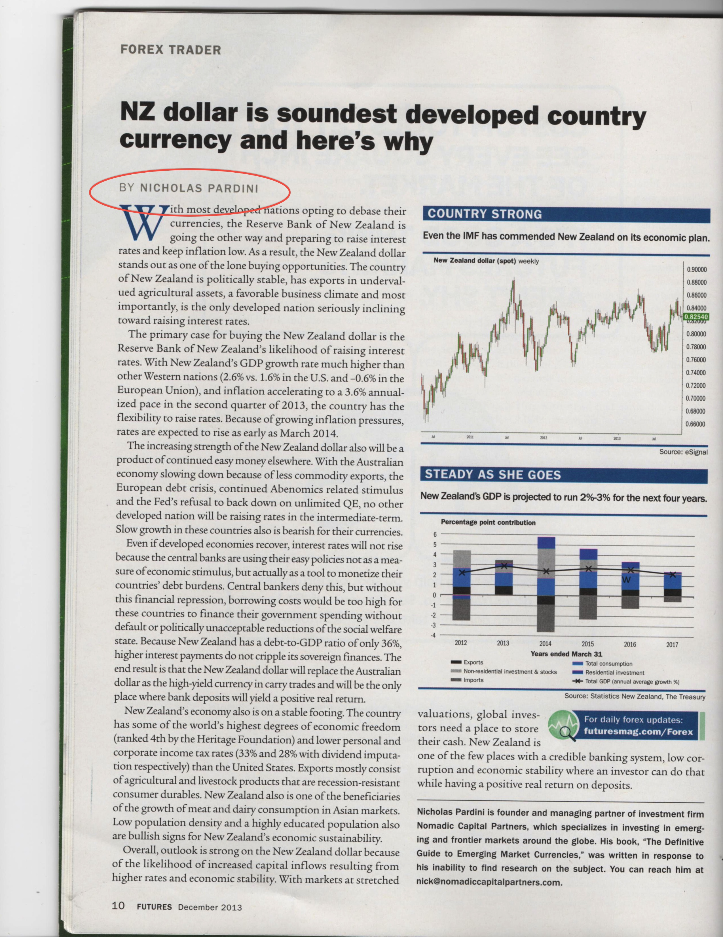
Do: Start small
Attend industry conferences; have your elevator speech ready for allocators, press and brokers
Have your performance listed in database website. Be consistent. Always provide updates good and bad.
Determine what trade publications or websites appeal to you and where you would like to pursue a relationship.
Start your own blog or write columns

Slide 5
Do: Profiles
Be open to profiles on all levels

Slide 6
Do: Thought Leadership
Write articles on on your sweet spot
Provide technical chart commentary

Slide 7
Do: Smart promotion
Leverage your expertise: if you specialize in trading grains, get your name out there as an expert journalists can call upon for comments.
Make sure you have a website that is functional.
Set rules: be on the record, but be very clear with journalist if you are not on the record.
Send your commentary, blog links, previous work to appropriate publications/sites.
Be patient.

